Slide 1
Week 5 Class 2:
Graphs
INST408C: Cognitive Security | Fall 2021 | SJ Terp

Slide 2
Week 5
Monday
Frameworks for understanding cognitive security
Layer-based models
Object-based models
Behaviour-based models
Introduces students to infosec-related models of information operations and disinformation, with examples of their use and connection to other information security practices.
Outcome: students will be able to evaluate disinformation incidents and their components.
Wednesday
Relationship models
Graphs
Groups
Readings
Pamment’s ABCDE paper
Assignments

Slide 3
Aside: Toolsets

Slide 4
Typical tool needs
Data gathering:
Internet: looking for trends, known narratives, new narratives, and risk activity in social media, websites, and other places that people seek and share information online. Media: looking for trends, known narratives, new narratives, and risk activity in traditional mass media, including newspapers, radio, and TV. Some of this monitoring can be covered by searching media’s internet sites.
Other channels: messaging apps and word of mouth misinformation sharing cannot usually be tracked using internet monitoring tools. However, surveys, chatbots and other social listening tools can help to surface infodemic narratives and artifacts in these “dark” channels.
Analysis:
Situation assessment: making sense of the often-large volumes of data produced by monitoring.
text analysis: help identify and track narratives
graph analysis: help map information flows, find influencers, and identify and track coordinated online activity.
Information sharing:
Share information between teams of human analysts;
Response:
Message-based: getting prebunking, debunking and other messages to community segments in the channels that they use or trust, in forms they’re familiar with (e.g. languages, message styles, literacy levels, cultural appropriateness).
Other: sharing artifacts with platforms and other responders.

Slide 5
My toolset
Data gathering
Crowdtangle
Tineye / Yandex
Hypothes.is
Hootsuite
Maltego
Profil3r
CheckUserNames
Data storage and sharing
CSVs
STIX / TAXII
Archive.org
Analysis
Jupyter notebooks
Python libraries
Gephi
AMITT Navigator
inVid
BuiltWith
Information sharing
MISP
Ticketing system
Googledocs
Spreadsheets
Response
Googledocs & spreadsheets
Notes:
Ticketing system, e.g. Jira
A good place to start is First Draft’s list of tools: https://start.me/p/vjv80b/first-draft-basic-toolkit

Slide 6
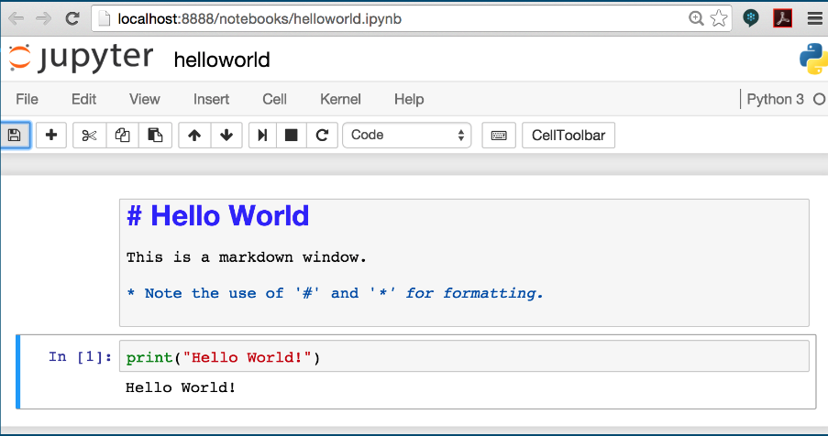
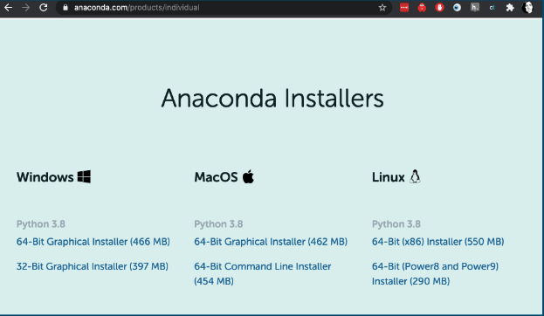
Jupyter notebook
https://www.anaconda.com/products/individual
Notes:
https://www.anaconda.com/products/individual - if you’re not sure what to choose, grab the graphical installer for the machine you’re on.
Click “continue” a lot. And yes, you do want the PyCharm IDE (I write python code using SublimeText, but PyCharm really is a lovely tool, and again if you’re not sure, just use it).

Slide 7
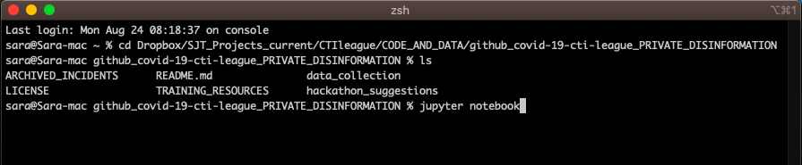
Starting Jupyter
Open a terminal window
Move to the directory you want to run code from
Type “jupyter notebook”
Notes:
cd (“change directory”) is the terminal window command to change directory.
“cd ~” takes you to your ‘top’ directory, where typing “ls” (mac) or “dir” (windows) will show you directories like Desktop, Downloads or Documents.
“cd dir1/dir2/dir3” takes you ‘down’ directories, to dir3 which is below dir2 which is below dir1. This is the terminal equivalent of starting in one directory, then clicking on dir1, dir2 then dir3.
“cd ..” takes you ‘up’ directories: for instance, “cd ..” in dir3 will take you to dir2.
“pwd” (mac) or “dir” (windows) will show you which directory you are in at the moment. If you get lost, “cd ~”.
Now sometimes this will go wrong… Google search, and your friendly community, are your friends here.

Slide 8
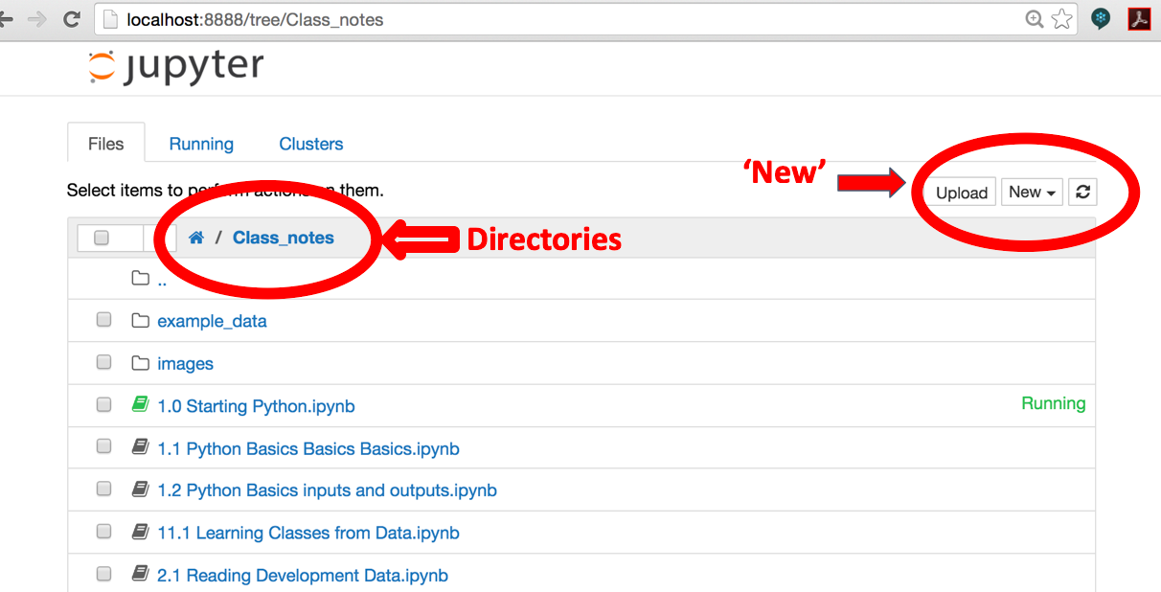
What you get: the Jupyter Dashboard
Notes:
A browser window will open. In it you’ll see a list of files - the ones in the directory you typed “Jupyter notebook” from. You can open most of these in Jupyter. Some of them will make sense.
Jupyter starts with the Dashboard view. This lists all the files in the directory that you called iPython from, including directories. If you accidentally delete this view, open a web browser and type “localhost:8888” in the address window to get back to it.
Things you need to know about in here:
The “New” button on the top right hand side. Click on this, then “Python 3”, to create a new iPython notebook file.
The file listing. Click on any file or directory to open it.
The current directory (the grey bar above the files list): click on this to go back up from a directory.
Jupyter notebooks are files that contain both formatted text and code; depending on how you set up your notebooks, they can run code written in Python, R or several other languages.
Jupyter notebooks were originally called ipython notebooks: they’ll be called this in many places online, but apart from the name change, they’re fundamentally the same thing: text and code, mixed together, and any instructions for ‘ipython notebook’ will work for ‘jupyter notebook’ too.

Slide 9
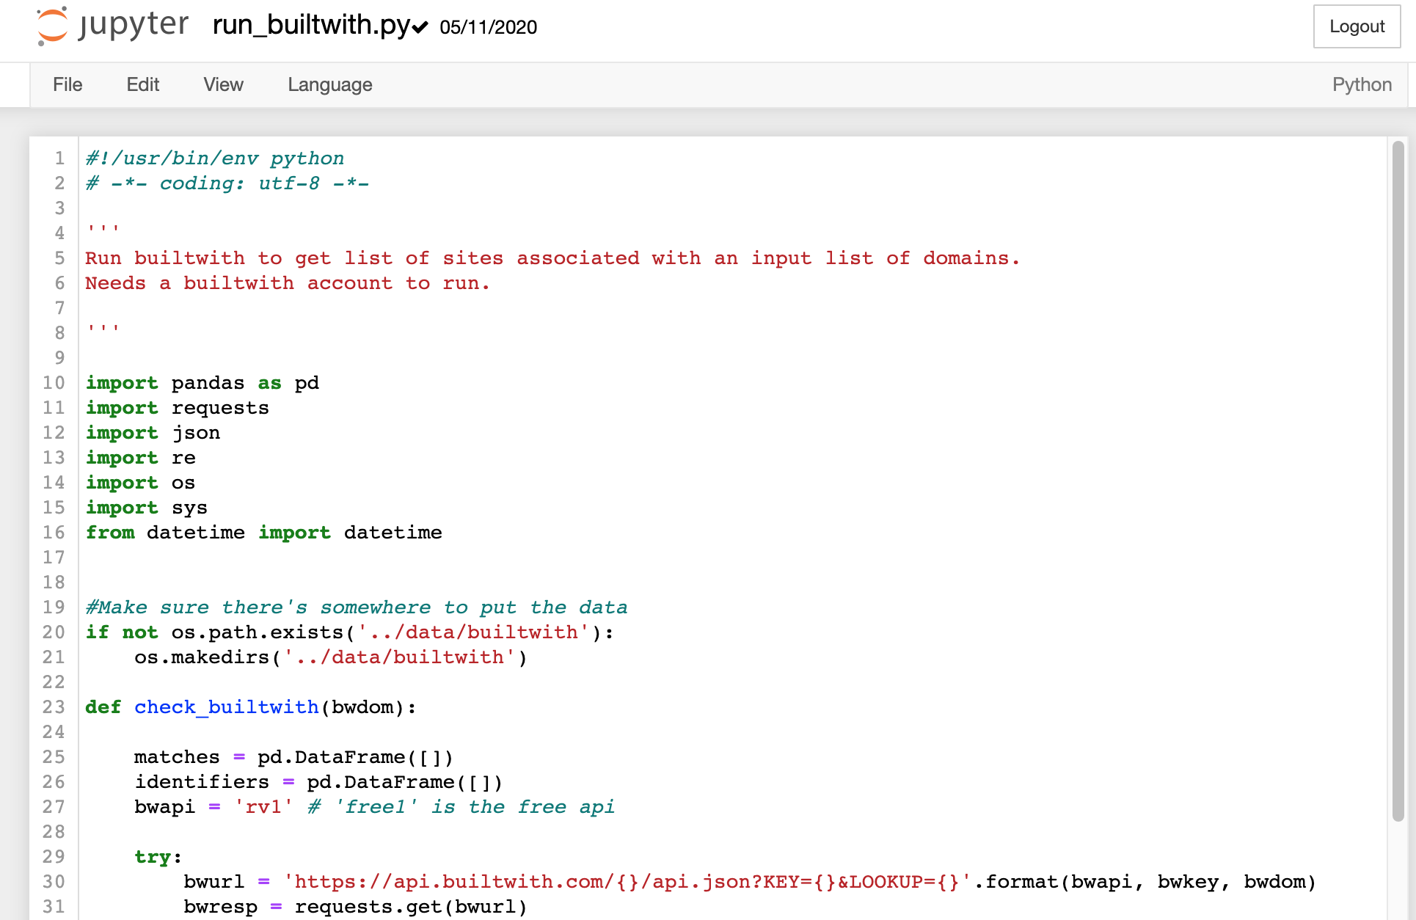
Code file in Jupyter
Notes:
If you open up (click on the filename in the jupyter dashboard) a code file in jupyter, you’ll see this. The code, handily colour-coded to show comments, variables etc.

Slide 10
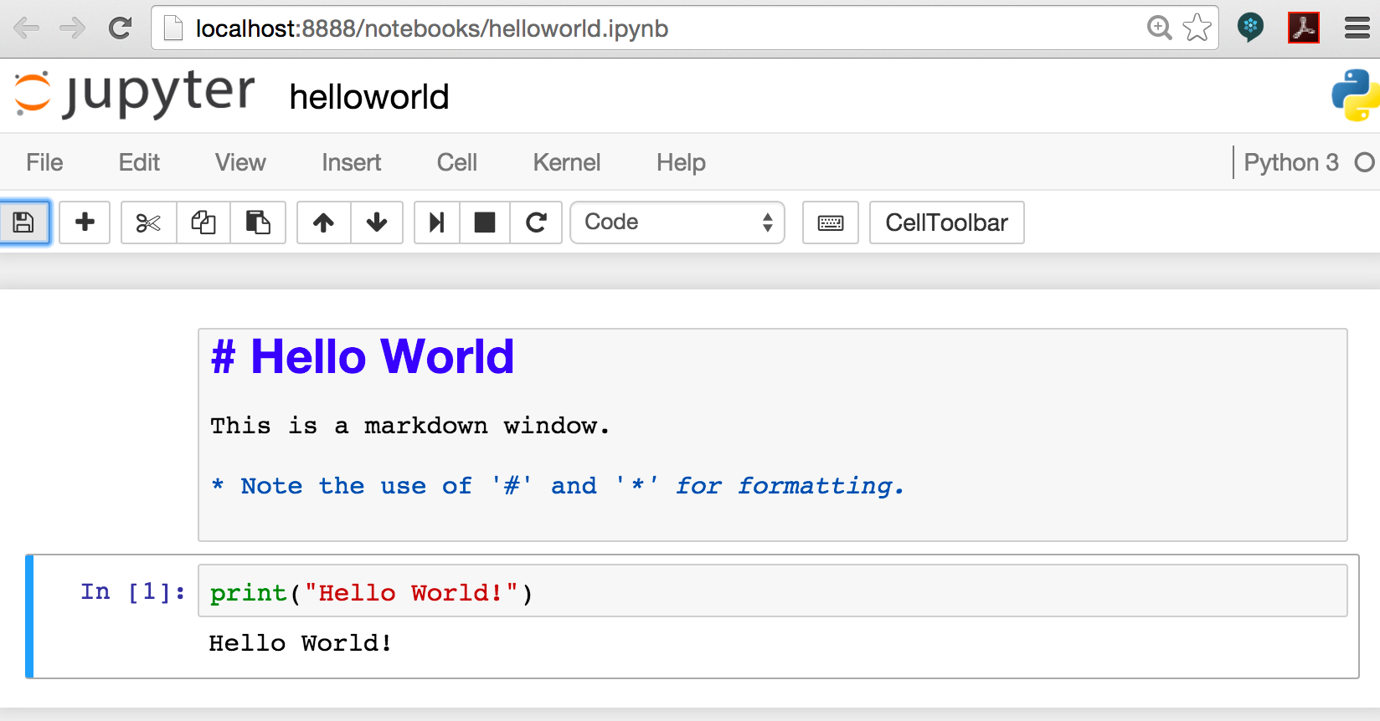
Jupyter notebook in Jupyter
Notes:
And this is what you see when you open a Jupyter notebook.
The grey boxes are called ‘cells’.
You create a new cell by clicking ‘Insert’ on the top menu.
You change the cell type (to ‘Markdown’, or ‘Code’) by clicking the box that currently says ‘Code’
You run a cell by clicking in the cell, then clicking ‘cell’ -> ‘run cells’.
You change your file’s name by clicking the name to the right of jupyter
You save your shiny new file by clicking ‘File’ -> ‘Save and Checkpoint’.

Slide 11
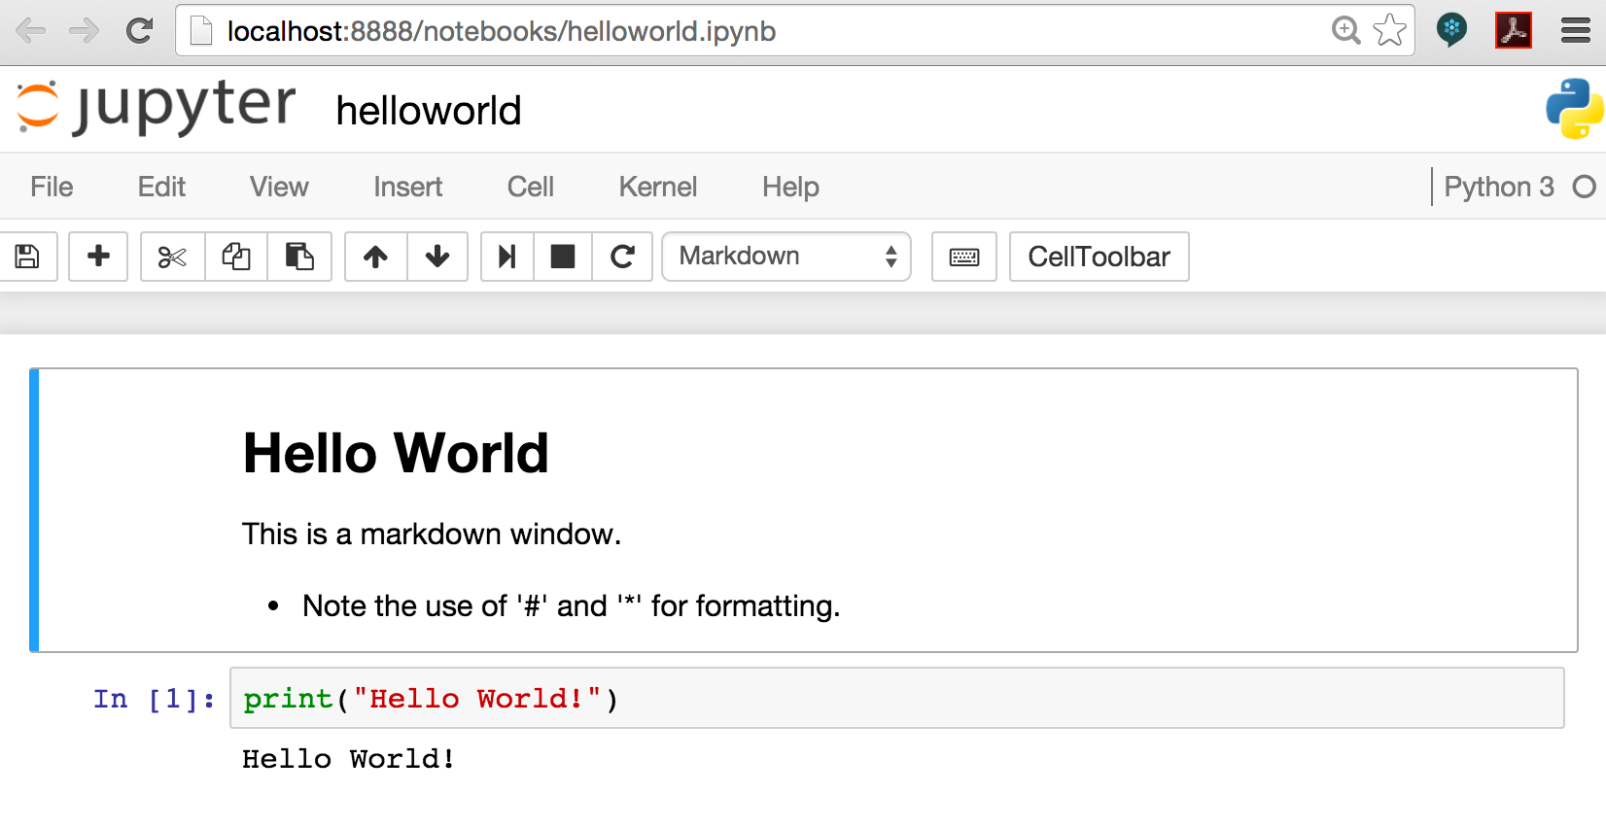
Jupyter Notebook: Print View
Notes:
Don’t panic if your notebook looks like this when you open it. iPython has helpfully converted your markup cells into the way you’d see them if you printed the notebook. To edit any of these cells, click in the cell (you should then see the markdown code, ready to edit).

Slide 12
Relationships are everywhere

Slide 13
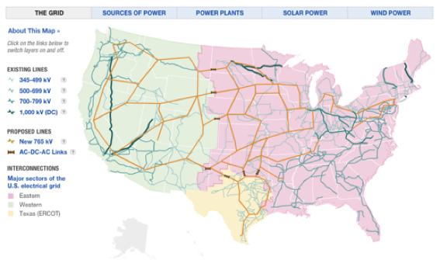
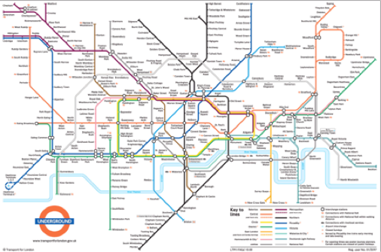
Infrastructure
Notes:
Let’s start with networks where there’s an obvious physical link. These include things like communications grids, power grids, and the movement of water supplies between streams, rivers, farms and processing plants.
As you look at these examples, I want you to think about the types of questions you could start asking with this network data. For example, in infrastructure, you often only have access to the junctions and the fact that there *is* a connection between two points. One question here might be “are there any critical links here”, e.g. if one link fails, could it break the grid, or stop an area being supplied with electricity? Image: the main power grid in the USA, from NPR: Visualising the US Power Grid
With transport, the dataset gets richer. You not only have the nodes and links between them, you also have timetables that list the average time between stations (and the current state of the network) and the switching costs of changing lines at a station (e.g. the time taken to walk between platforms). Image from Transport for London: London Underground Map
We’re infosec people - the obvious networks for us are things like internet backbones. Still networks. Still things we can reason about and apply math to.

Slide 14
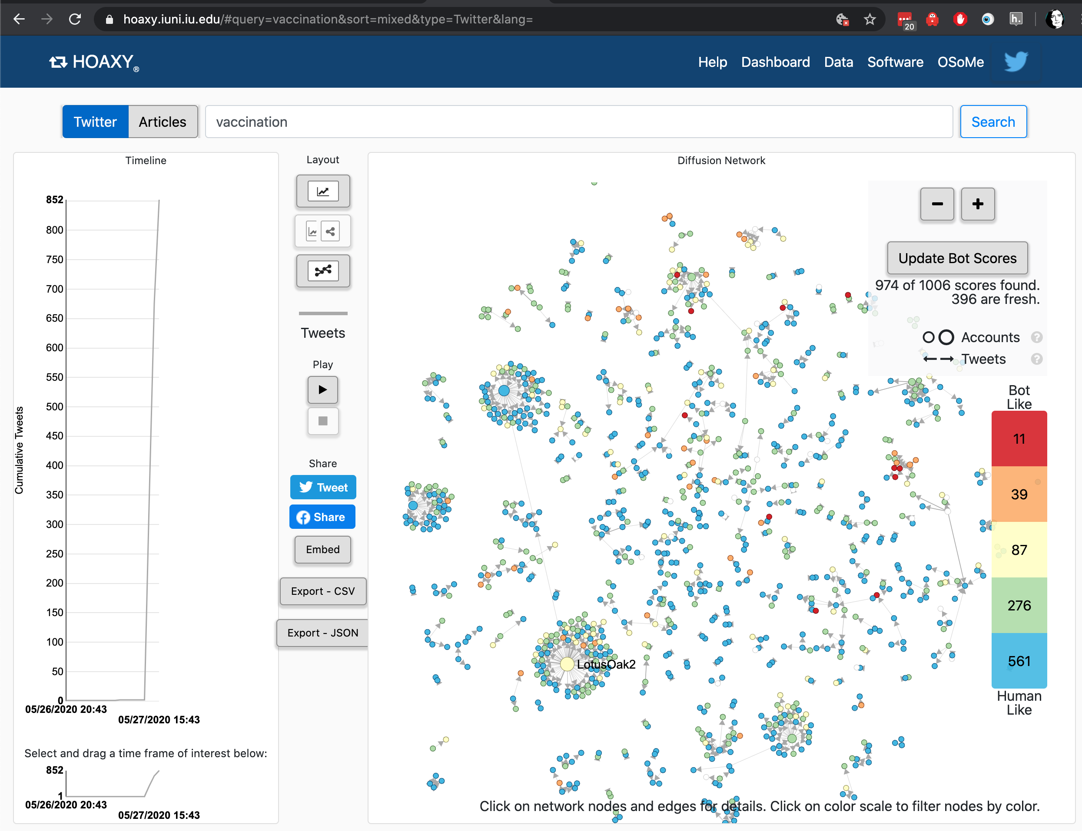
Social Media accounts
Notes:
UIndiana toolset (Hoaxy) https://hoaxy.iuni.iu.edu/#query=vaccination&sort=mixed&type=Twitter&lang= which uses Gephi to visualise Social Media networks.
We have instructions for how to run twitter through Gephi in the BigBook too.

Slide 15
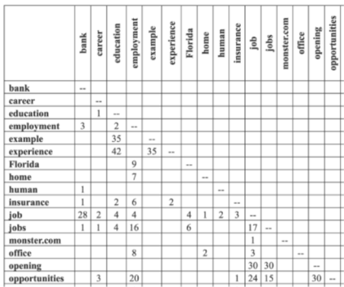
Word co-occurrence
Notes:
Much of text analysis can also be framed as networks. Here’s a matrix showing words that occur together in sentences and how many times they’ve co-occurred in the dataset. If we see every words as a node, and every nonzero co-occurrence score as a link, we’ve got ourselves a network. This can also be applied at the document level, e.g. Jonathan Stray’s Overview project analysed networks of documents to find civilian deaths in the Iraq War.
We could also use this on hashtags, e.g. build a network of the hashtags that are used together.
Image: (Wise blogpost on word co-occurance matrices)

Slide 16
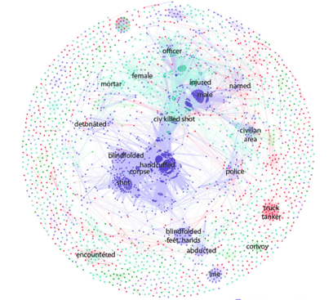
Document Similarity
Notes:
Image: http://jonathanstray.com/a-full-text-visualization-of-the-iraq-war-logs - colours are types of events being described.
Documents are often clustered using latent dirichlet methods; this is what was used on the Panama papers.

Slide 17

Image and video similarity
Notes:
Lots of ways to compare images
Getting label probabilities from something like Rekognition
Deep ranking e.g. https://medium.com/@akarshzingade/image-similarity-using-deep-ranking-c1bd83855978
But it can all be converted into networks in the end…

Slide 18
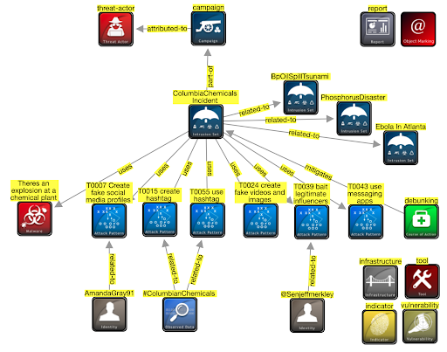
AMITT STIX

Slide 19
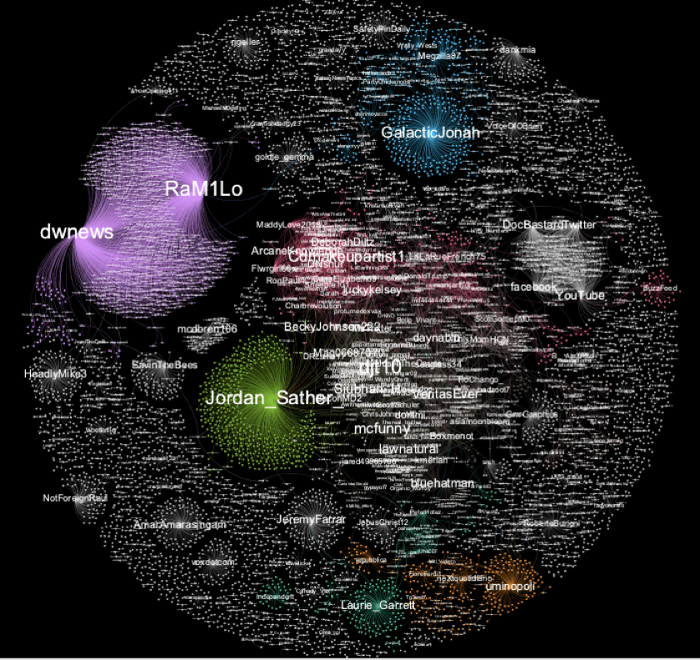
Social media influence

Slide 20
Relationships in cognitive security
Social media accounts
Hashtags
URLs
Images
Text
Documents
Groups
...

Slide 21
Social network analysis
Notes:
Mapping and measuring relationships and information flows between people, groups, URLs, and other information entities.
Techniques and tools for assessing the relationships between disinformation artifacts, narratives, and other incident objects.

Slide 22
Activities
Understand structure & relationships
Get data
Find relationships in data
Convert to graph
Find structures in graph
Interpret structures
Bonus: monitor results of actions
Take action
Analyse structures
Adapt actions

Slide 23
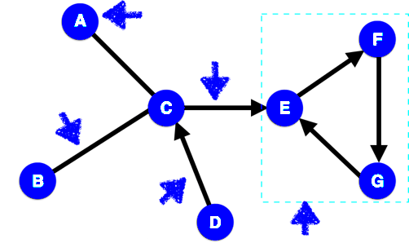
Relationships as Graphs
Node
Edge
Undirected edge
Directed edge
Clique
Notes:
We’re going to be dealing with simple networks. These each have features, that we need to be able to name.
Node: object in the network (e.g. two people)
Edge: link between two objects (e.g. a friendship)
Directed edge: link for a relationship that just goes one way (e.g. a ‘friends’ b, but b doesn’t ‘friend’ a).
Clique: set of nodes where every node in the clique is connected every other node in the clique.

Slide 24
Network Tools
Standalone analysis tools:
Gephi
NodeXL
Cytoscape
(NetMiner)
Standalone visualisation tools:
D3.js
Python analysis libraries:
NetworkX
Python visualisation tools:
Matplotlib
Notes:
Longer list: http://en.wikipedia.org/wiki/Social_network_analysis_software

Slide 25
Network analysis
Analysis tools
Gephi does this. In Python, NetworkX is simple to use
Node-based questions
Centrality: how important is each node to the network?
Community detection: what type of groups are there in this network?
Transmission: how might (information, disease, etc) move across this network?
Network characteristics: what type of network do we have here?
Network-based questions:
Characteristic path length: average shortest distance between all pairs of nodes
Clustering coefficient: how likely a network is to contain highly-connected groups
Degree distribution: histogram of node degrees
Disconnection
(scale-free networks)
And also
Overlapping community detection (modularity etc)
Homophily (how node dissimilarity affects networks)
Graph cohesion (which nodes strengthen or weaken a network)
Graph skeletons (e.g. minimum spanning trees)
Marketing metrics (reach etc)
Notes:
Classic modularity algs: https://www.cs.cmu.edu/~ckingsf/bioinfo-lectures/modularity.pdf

Slide 26
Centralities: who has what influence
Degree centrality: who has lots of friends
Betweenness centrality: who are the bridges
Closeness centrality: who are the hubs
Eigenvalue centrality: who has most influence
Notes:
Eigenvector centrality measures how much influence a node has in the whole network, taking account of their connections to other highly-connected nodes. These are the “kings” of your network - they might not have great closeness or betweenness, but they do wield a lot of influence. The algorithm behind Google search, PageRank, is based on eigenvector centrality.
NB Eigenvector centrality algorithms are complex, and won’t always give you a solution.

Slide 27
Communities: what are the groups in a network
Communities = groupings within your network.
Useful for questions like
“how is a network likely to split into groups” and
“how do I efficiently influence this network”.
Note that when we have a community, we can study it as a network in its own right, including finding the most important nodes in it.
Notes:
“Small world theory” = there are roughly 6 steps on the shortest path between each pair of nodes in the world (see also “6 degrees of Kevin Bacon” http://en.wikipedia.org/wiki/Six_degrees_of_separation). The maths works out at roughly s = ln(n)/ln(k) where n is the population size and k is the average number of connections per node. For k=30, s is usually roughly 6.
NetworkX community functions: http://networkx.lanl.gov/reference/algorithms.community.html

Slide 28
Graph representations

Slide 29
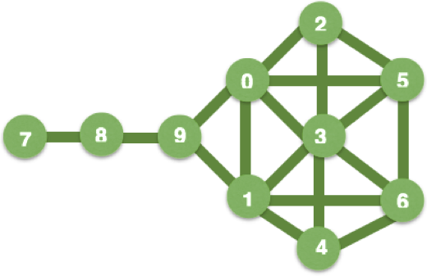
Network representation: diagram
Notes:
We’re going to look at the same network, using all the different ways that network tools could represent it. First up: a diagram, basically a visualisation of all the network’s node and links. Diagrams are good for explaining a network (and can be interactive)

Slide 30
Representation: adjacency matrix
[[ 0, 1, 1, 1, 0, 0, 0, 0, 0, 1],
[ 1, 0, 0, 1, 1, 0, 1, 0, 0, 1],
[ 1, 0, 0, 1, 0, 1, 0, 0, 0, 0],
[ 1, 1, 1, 0, 1, 1, 1, 0, 0, 0],
[ 0, 1, 0, 1, 0, 0, 1, 0, 0, 0],
[ 0, 0, 1, 1, 0, 0, 1, 0, 0, 0],
[ 0, 1, 0, 1, 1, 1, 0, 0, 0, 0],
[ 0, 0, 0, 0, 0, 0, 0, 0, 1, 0],
[ 0, 0, 0, 0, 0, 0, 0, 1, 0, 1],
1, 1, 0, 0, 0, 0, 0, 0, 1, 0]]
Notes:
An adjacency matrix is an n by n grid, with 1 row and 1 column for each network node, a “1” everywhere a link exists, and a ‘0’ everywhere else. Adjacency matrices are good for representing dense graphs (i.e. graphs with lots of links between nodes).
You can also represent ‘sparse’ graphs using an adjacency matrix, but these will have lots and lots of zeros in them. The Python scipy.sparse library is useful is you want to represent very large sparse matrices, without taking up huge amounts of memory.

Slide 31
Representation: Adjacency List
{0: [1, 2, 3, 9],
1: [0, 9, 3, 4, 6],
2: [0, 3, 5],
3: [0, 1, 2, 4, 5, 6],
4: [1, 3, 6],
5: [2, 3, 6],
6: [1, 3, 4, 5],
7: [8],
8: [9, 7],
9: [8, 1, 0]}
Notes:
An adjacency list is a list of a the nodes, with a list of all the nodes connected to each of them.
An adjacency list is good for representing sparse graphs (e.g. social networks tend to be sparse), and is the main network representation used by NetworkX.

Slide 32
Representation: Edge List
{(0,1), (0,2), (0,3), (0,9),
(1,3), (1,4), (1,6), (1,9),
(2,3), (2,5), (3,4), (3,5), (3,6),
(4,6), (5,6), (7,8), (8,9)}
Notes:
An edge list is a list of all the connections between nodes. This is a good general network representation.
You’ll also find networks described in mathematical terms, e.g. as “G = (V,E,e)” where G is the network (‘graph’), V are the nodes (‘vertices’); E are the edges and e is the relationship (‘mapping’) between edges and nodes. Networks are covered by areas of maths that include Graph Theory.

Slide 33
Gephi: community visualisation and analysis

Slide 34
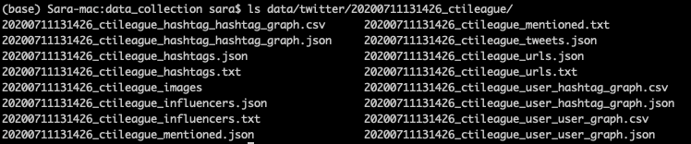
Gephi: get dataset
Get data collection code: https://github.com/cogsec-collaborative/amitt_tracking/blob/master/andypatel_get_data.py
In terminal window, type: “python andypatel_get_data.py ctileague”
This creates a directory with files:
User-user: counts replies, retweets, quotes, mentions
Hashtag-hashtag: counts co-occurrences
User-hashtag: counts hashtag use

Slide 35
Gephi: create graph
Get tool: https://gephi.org/users/download/
Build graph:
Start Gephi. Click on top menu>file>“import spreadsheet”. Grab User_user_graph.csv - use all defaults
Top menu: Go to data laboratory, “copy data to another column”, click ‘id’, click okay.
Go to overview. RHS: Run modularity algorithm, using defaults
RHS: Run average weighted degree algorithm
LHS: Click color icon, then partition, modularity class. Open palette, generate, unclick “limit number of colors”, preset=intense, generate, okay
LHS: Select “tt”, ranking, weighted degree, set minsize=0.2, choose 3rd spline, apply
LHS: Layout: OpenOrd, run. Then forceatlas2, run. Try stronger gravity, and scaling=200
Top menu: Preview - select “black background”, click “refresh”. Click “Reset zoom”

Slide 36
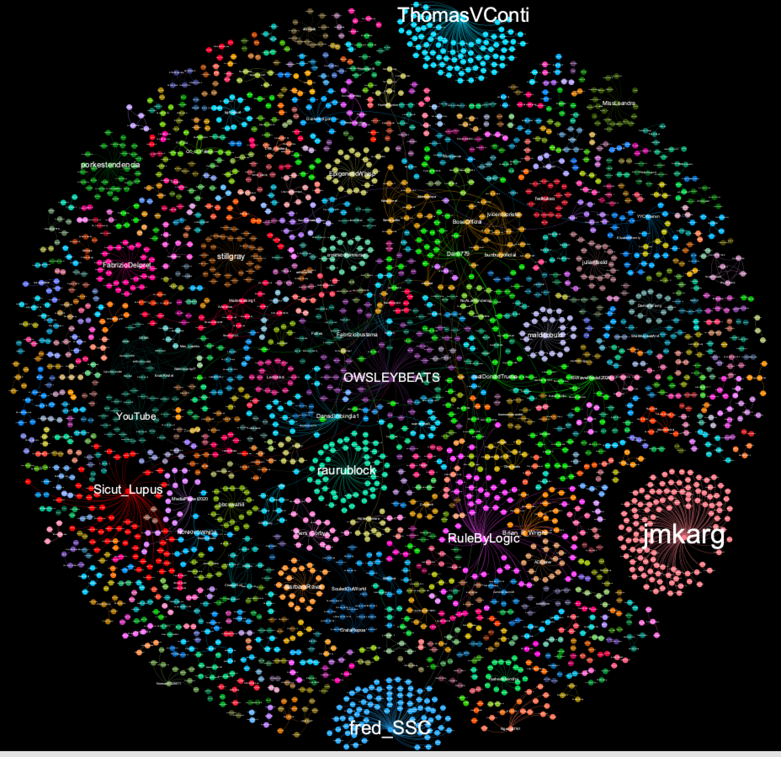
Covid5G
Notes:
Graph: Covid5G

Slide 37
U Indiana data tools
Notes:
https://hoaxy.iuni.iu.edu/#query=vaccination&sort=mixed&type=Twitter&lang=
Hoaxy uses Gephi

Slide 38
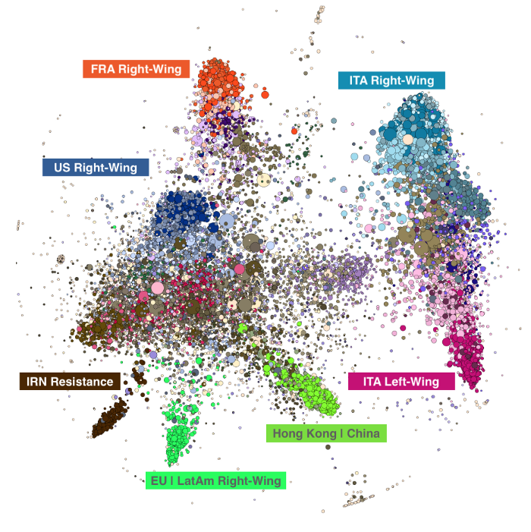
Why we care
https://points.datasociety.net/who-benefits-from-health-misinformation-8d094804058d

Slide 39
NetworkX python library: network analysis
Notes:
This is where you need a Jupyter notebook

Slide 40
This is where you need that Jupyter notebook

Slide 41
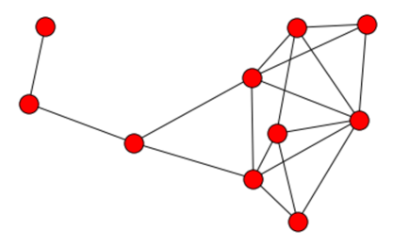
Getting graphs into NetworkX
import networkx as nx
edgelist = {(0,1), (0,2), (0,3), (0,5), (0,9), (1,3), (1,4), (1,6), (1,9), (2,3), (2,5), (3,4), (3,5), (3,6), (4,6), (5,6), (7,8), (8,9)}
G = nx.Graph()
for edge in edgelist:
G.add_edge(edge[0], edge[1])
Notes:
So let’s try some of this. NetworkX produces ugly graphs, but has a good set of network analysis tools.
(NB if you want a directed graph, use nx.DiGraph() )
… and now you can do G.nodes and G.edges to see what’s in your graph
NB NetworkX has visualisations: import matplotlib, and use nx.draw(G) to see them. They’re not pretty: when humans draw graphs, they generally think about where to put the nodes, minimise the number of links crossing over each other, make them pretty. Computers don’t think that way, so don’t be surprised if NetworkX draws something that doesn’t look, on the surface, anything like your graph. “Making it pretty” is one of the reasons that we use packages like Gephi to visualise graphs (another is “make it easier to spot patterns in this graph”).

Slide 42
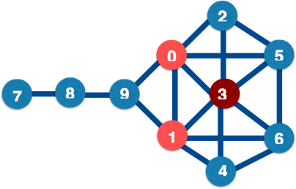
Degree Centrality: who has lots of friends?
nx.degree_centrality(G)
3 0.666
0 0.555
1 0.555
5 0.444
6 0.444
2 0.333
4 0.333
9 0.333
8 0.222
7 0.111
Notes:
Centrality is all about power. And there are different types of power. The simplest form of centrality is degree centrality, e.g. how many links connect directly to each node.
NetworkX centrality functions are here: http://networkx.lanl.gov/reference/algorithms.centrality.html Note that degree centrality is normalized (divided) by the largest possible number of connections per node: in this case, 9.
Degree centrality is not a great measure of power: a more important measures may be the number of nodes that each node can easily reach, and it’s possible that the highest-ranked node by degree centrality is part of a clique that’s not well connected to the outside world.

Slide 43
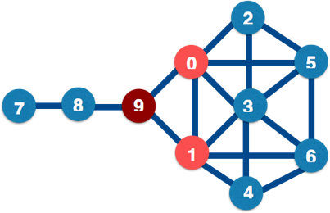
Betweenness Centrality: who are the bridges?
nx.betweenness_centrality(G)
9 0.38
0 0.23
1 0.23
8 0.22
3 0.10
5 0.02
6 0.02
2 0.00
4 0.00
7 0.00
Notes:
Between = how many nodes are there between two nodes?
Nodes with high betweenness have influence over the flow of information or goods through a network: they bridge separate communities (good) but also often are a single point of failure in communications between those communities (bad).
Betweenness = (number of shortest paths including n / total number of shortest paths) / number of pairs of nodes

Slide 44
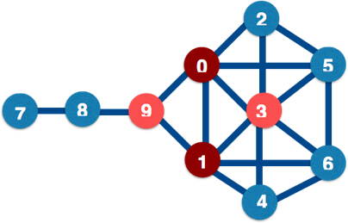
Closeness centrality: who are the hubs?
nx.closeness_centrality(G)
0 0.64
1 0.64
3 0.60
9 0.60
5 0.52
6 0.52
2 0.50
4 0.50
8 0.42
7 0.31
Notes:
Closeness = has the shortest average path to all other nodes in the network. Nodes with high closeness have great influence over the rest of the network, especially if influence diminishes with path length; these points are also good places to observe all information flows from.
Closeness = sum(distance to each other node) / (number of nodes-1)

Slide 45
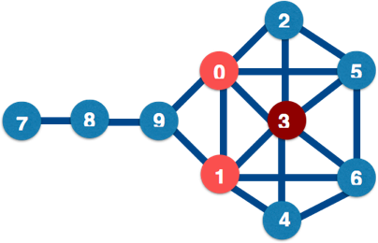
Eigenvalue centrality: who has most influence?
nx.eigenvector_centrality(G)
3 0.48
0 0.39
1 0.39
5 0.35
6 0.35
2 0.28
4 0.28
9 0.19
8 0.04
7 0.01
Notes:
Eigenvector centrality measures how much influence a node has in the whole network, taking account of their connections to other highly-connected nodes. These are the “kings” of your network - they might not have great closeness or betweenness, but they do wield a lot of influence. The algorithm behind Google search, PageRank, is based on eigenvector centrality.
NB Eigenvector centrality algorithms are complex, and won’t always give you a solution.

Slide 46
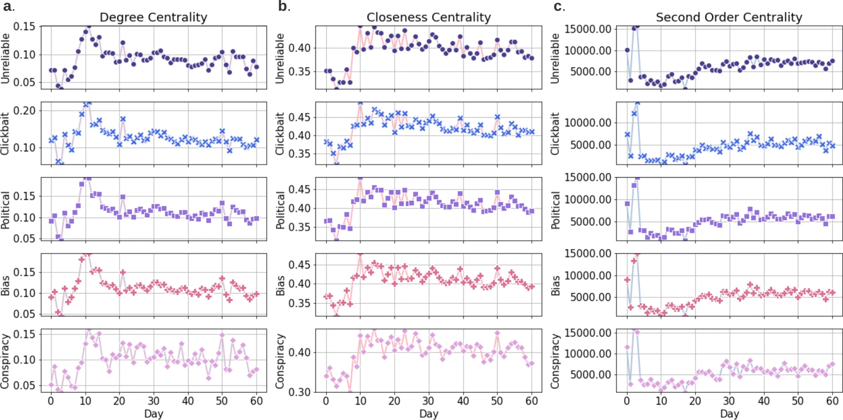
Why we care
Image from https://www.nature.com/articles/s41598-021-89202-7

Slide 47
Communities
Communities = groupings within your network.
Useful for questions like
“how is a network likely to split into groups” and
“how do I efficiently influence this network”.
Note that when we have a community, we can study it as a network in its own right, including finding the most important nodes in it.
Notes:
“Small world theory” = there are roughly 6 steps on the shortest path between each pair of nodes in the world (see also “6 degrees of Kevin Bacon” http://en.wikipedia.org/wiki/Six_degrees_of_separation). The maths works out at roughly s = ln(n)/ln(k) where n is the population size and k is the average number of connections per node. For k=30, s is usually roughly 6.
NetworkX community functions: http://networkx.lanl.gov/reference/algorithms.community.html

Slide 48
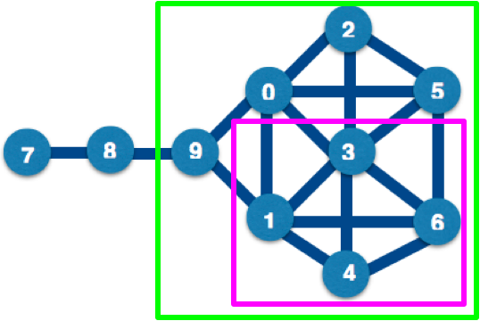
Communities: Cliques and Cores
nx.find_cliques(G)
nx.k_clique_communities(G, 2)
Notes:
These are group measures based on the numbers of links. The K-core is defined as: Every node in the clique is connected to K or more other nodes in the clique.
Clique-level analysis and node-level analysis interact with each other, e.g. if you find a set of cliques in a network, you can then look for and use the central nodes in those cliques.
In this graph, the largest cliques have 4 nodes in them: for instance, the nodes in the pink box are all connected to each other. There are two 4-cliques in this diagram ([[0,2,3,5],[1,3,4,6]]), two 3-cliques: [[0,1,3],[0,1,9]], and two 2-cliques: [[7,8],[8,9]]. The largest k-cores is a 2-core, with the green box around it: [0,1,2,3,4,5,6,9].
K-cores and cliques don’t always find the natural cliques in a graph (especially one containing human relationship). N-cliques: “friend of friend” cliques; use Bron and Kerbosch algorithm. Issues include nodes that contribute to the clique aren’t included in it. P-clique addresses some of this. Other approaches: n-clans, k-plexes etc.: see http://faculty.ucr.edu/~hanneman/nettext/C11_Cliques.html#nclique

Slide 49
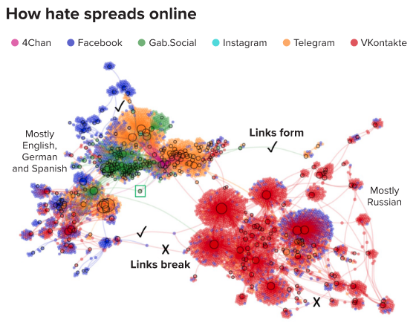
Why we care
https://knowablemagazine.org/article/society/2021/how-online-misinformation-spreads

Slide 50
Contagion

Slide 51
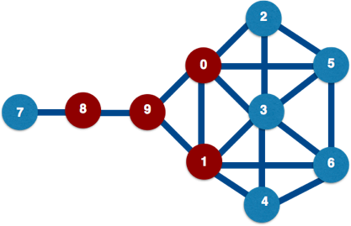
Simple contagion: always transmit
Notes:
Simple contagion (aka diffusion) models are used when it’s important that you find *everybody* in contact, e.g. for Ebola, you have to assume that everyone an infectious person is in contact with is a potential carrier. Here, we assume that node 9 changes state first; in the next step of the algorithm, the nodes directly connected to it (0,1,7) change state; in the next step, the nodes connected to (0,1,7) change state, etc. etc.
Thought experiment: infections are time-sensitive, e.g. you get infected, then either get better or die. How would you represent this in a network? What would you expect to happen in a small-world network?

Slide 52
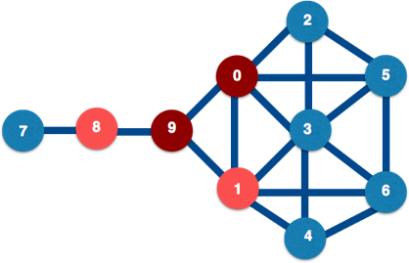
Complex contagion: only transmit sometimes
Notes:
Complex contagion are diffusion models for more complex choices, e.g. whether to go see a movie, based on your friends’ opinions plus reading movie reviews.
In complex contagion, a node changes state based on the state of *all* its neighbors, and often also on outside information; just because 9 is in one state, 1 doesn’t have to change to that state too (but it might change state with probability p).

Slide 53
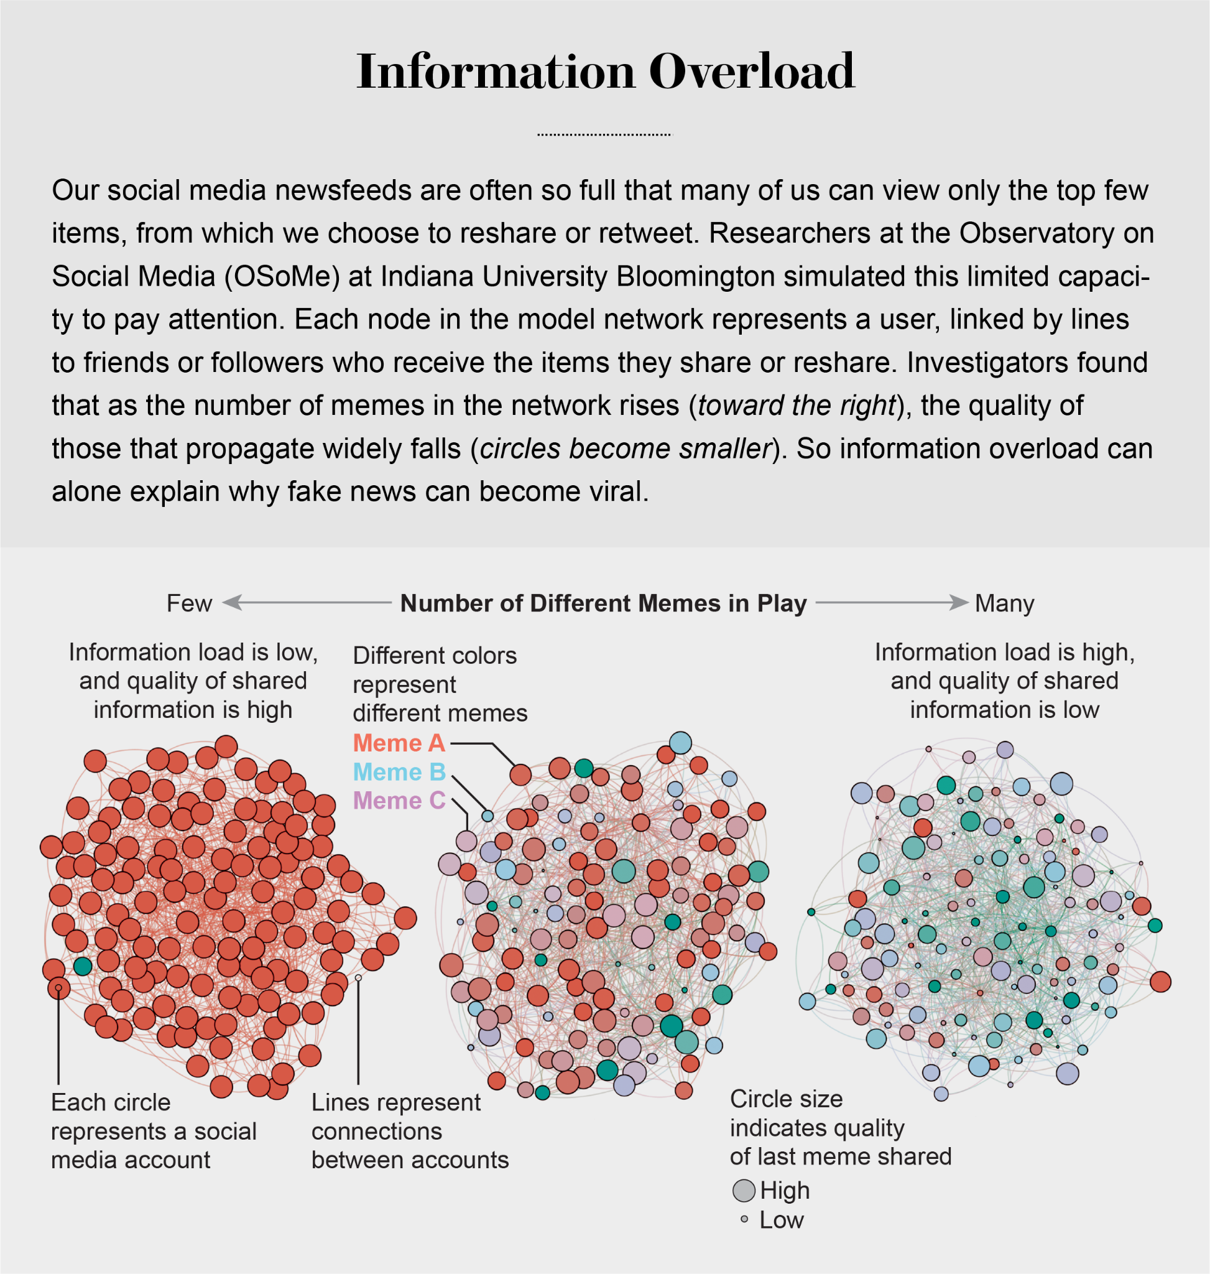
Why we care
https://www.scientificamerican.com/article/information-overload-helps-fake-news-spread-and-social-media-knows-it/
Notes:
Image from https://www.scientificamerican.com/article/information-overload-helps-fake-news-spread-and-social-media-knows-it/

